Slide 1
Out Of Time: The Game
B00349622 – Kieran Lewis
B00349036 – Steven Benson
B00357866 – Angelika Kolodziej

Slide 2
Game idea & Overview
Out of Time is a Time Travelling 2D Side Scrolling Shooter
The game takes place in many different settings from Ancient Egypt all the way to the future of 2084
We thought a time travelling game would be fun as nowadays it’s quite rare.
We wanted a wacky style of time travel not a chronological order or a specific the character knows where he’s going

Slide 3
Game IDEA AND OVERVIEW CONTINUED
We wanted full control of the implementation, we wanted Health pickups, ammo pickups and new weapons for the player to use.
We wanted a boss at the end of the game who was behind everything but this had to be scrapped in the prototype

Slide 4
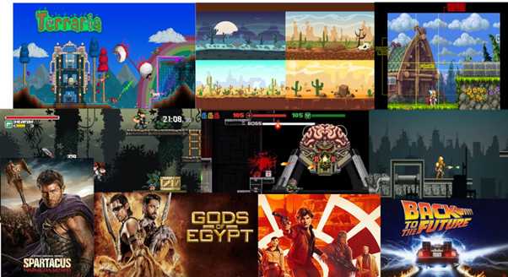
Inspiration
The game was heavily inspired from the Time Splitters series with some inspiration from films like Back to the Future, Bill and Ted’s Excellent Adventure and the tv show Doctor Who.

Slide 5
Game Engine Choice
We chose Unity 2017.3.1f1 because Kieran was most experienced in it compared to Unreal Engine 4.
It has worked in the past for many projects
Steven has good experience in Unreal Engine however he wanted to use Unity to build his skills in it again
It is easy to use and very user friendly
We didn’t use Unreal Engine because we haven’t ever made a 2D game in it

Slide 6
Gameplay and Mechanics
The game plays like a 2D Shooter.
The player moves along a linear path throughout each level and kills each enemy to get through the level.
Included a gun switching mechanic to spice up the game allowing multiple ways to defeat various enemies. Each gun performs differently from each other.
We wanted the game to feel quite fast however the game was slower paced at first

Slide 7
Gameplay and mechanics continued
Various enemies in the game that act differently. If certain enemies are hit too much then they will be slower
There are platforms that can move which adds a new sense of playability to the game.
There was originally to be a pistol, assault rifle, shot gun and laser pistol in the game, however this changed slightly.
Kieran created and implemented an RPG to the game as a replacement.

Slide 8
Team Roles
Angelika joined the group on Week 3 which meant our work load could increase and it also meant that the workload was more evenly spread.
Before this Kieran was Lead Programmer and Steven was Lead Artist.
Angelika became a team artist with Steven as she was good at art.

Slide 9
Level Design
We wanted each level to feel different but to still be similar to the overall gameplay loop
The levels progress in difficulty.
Steven hasn't finalised the final level designs but here are some rough pictures of the level designs:

Slide 10
Game Implementation
Originally we hade decided to go level by level as a team but the art work was taking longer than expected and Kieran was moving fast with the coding so we had to move forward and then go back when the art work was finished.

Slide 11
Immersive Qualities
When it came to the art of the game Steven knew that there should be a clear difference between the foreground and background.
Again with the same idea in mind we tried to get the pixel art as close to cultural realistic as possible so that the player wasn’t going “Something is off here!!!”

Slide 12
Version Control
As we used Github for uploading files to each other it meant we could download and upload files depending on the date the file was uploaded. This allowed us to keep track of the latest version.

Slide 13
Out of Time: Prototype Demo

Slide 14
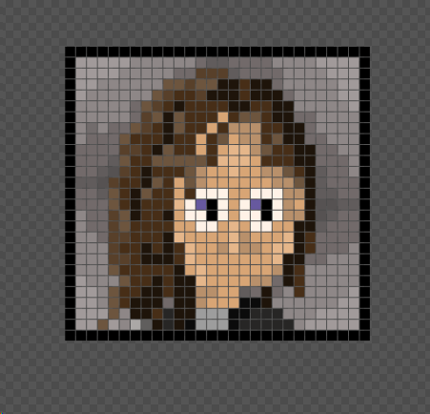
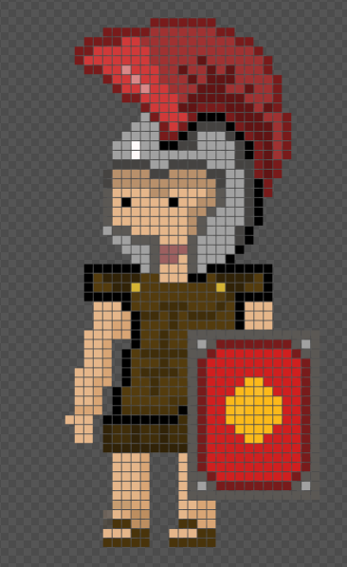
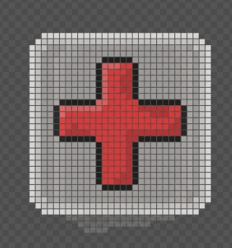
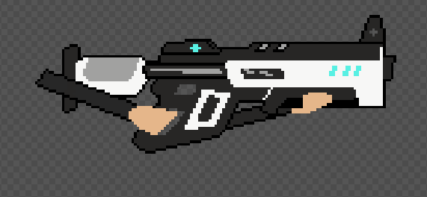
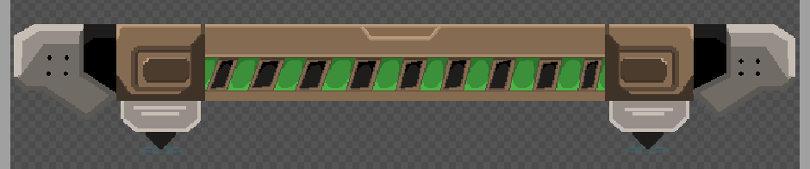
Individual Contribution
Creation List: Player profile picture, Pistol, Assault Rifle, Shotgun, Egyptian floors and platforms, Medieval floors and platform, Roman floors and platforms, Future floors and platforms, Health and Ammo pickups, coins and The roman soldiers.
Made a throwing animation for one of the Egyptian soldiers.
Worked on mood boards, concept art, visual style and creating the level designs.

Slide 15
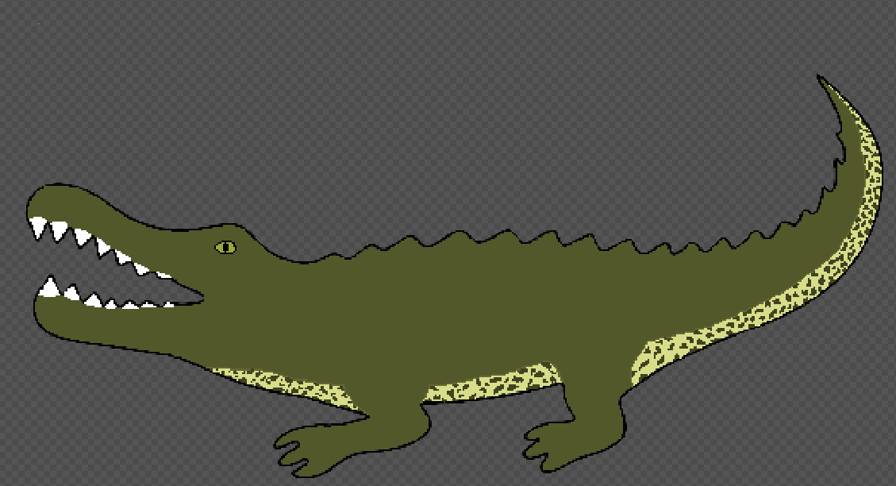
Future Development
For the future development we would of course complete the game and have the boss fight at the end.
We would add a few more objects such as boxes etc. that the player could break to fill out the game a bit and make it look more dense.
Steven came up with a few good ideas that change the game a bit.
The first idea was when you kill and enemy they fall into pieces like Lego or in the game Super hot.
The second idea would be to add animals to the game such as crocodiles or horses depending on the level. These could be used as enemy's or extra points for the player to get.
A crouch mechanic could be added to help make fighting the animals possible.

Slide 16
Learning experience as a team
We needed to face some problems with communication and Kieran decided to take the role of the leader in our group.
It was the first time Angelika needed to create Game Design Document so both Kieran and Steven needed to guide her through it.
It showed us what it was like if some people work faster than others as it shows how it can effect a project.

